Slide 1
Deep learning major task
Ahmed Amr Elgayar 19p8349

Slide 2
project
People Counting
Since the COVID-19 outbreak, people detecting and counting solutions have been growing in popularity, helping to enforce social distancing rules and improve safety.
The goal is to implement the studied deep learning CNNs to solve this problem.

Slide 3
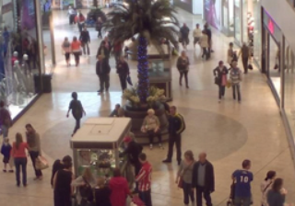
Dataset

Slide 4
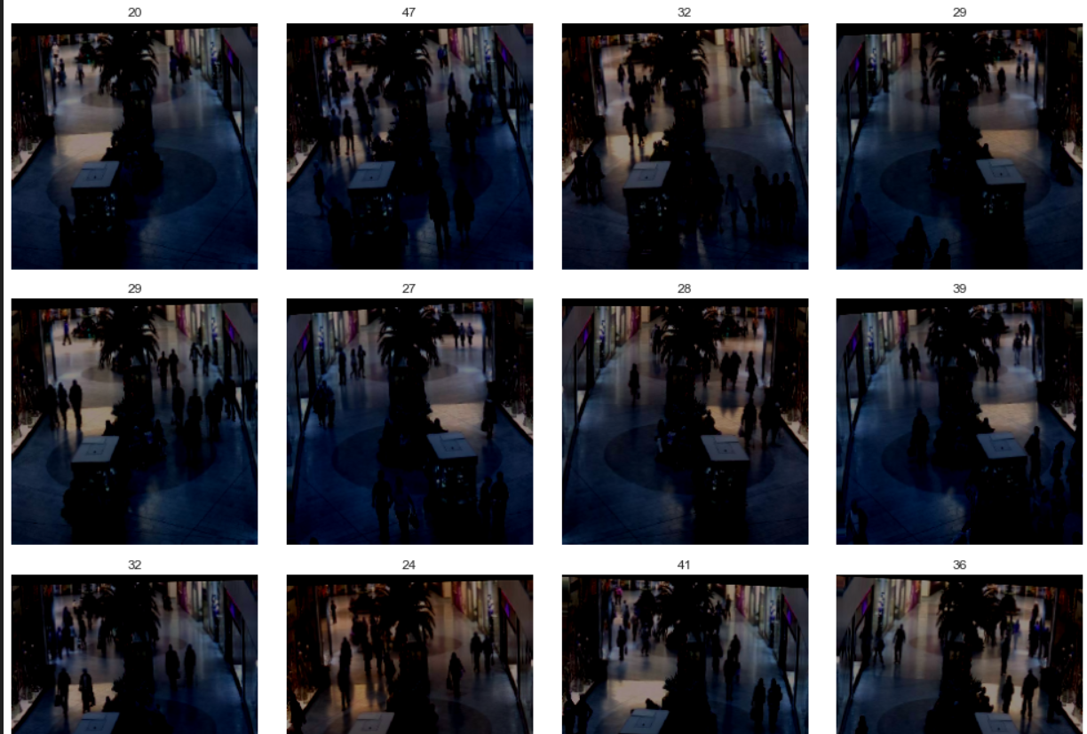

Slide 5
Steps
Data loading and augmentation
loading the pre-trained model
Add a global average pooling layer after the last convolutional block.
Removing the last fully connected layer and instead add a (dense, 1024, relu) fully connected layer with only 1 output (the number of people in the image)
Freezing the initial layers (all except last 7 layers) of the pre-trained model (which contain more generic features learned from a large dataset like ImageNet) to retain their pre-learned weights.
Unfreezing the later layers (last 7 layers) to adapt the model to the specific features of your dataset by updating their weights during training.
Define the optimizer - this function will iteratively improve parameters to minimize the loss.
Set a learning rate annealer - to have a decreasing learning rate during the training to reach efficiently the global minimum of the loss function.
Begin training (only on the last 7 layers)
Plot the loss training and validation curves.
Predict on entire validation set.
Plot a scatter plot of True vs. Predicted labels.
Compute MAE (mean average error), MSE (mean squared error), and R² score
Calculate the prediction accuracy, which is the percentage of correct predictions within a predefined threshold (10%)

Slide 6
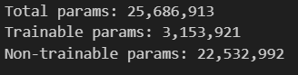
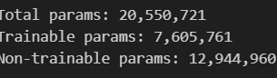
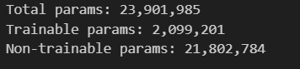
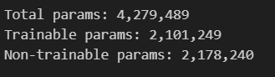
Resnet50 | VGG19
Inception v3 | Mobilenet

Slide 7
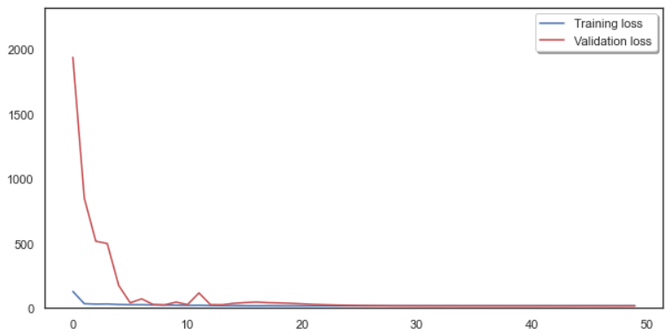
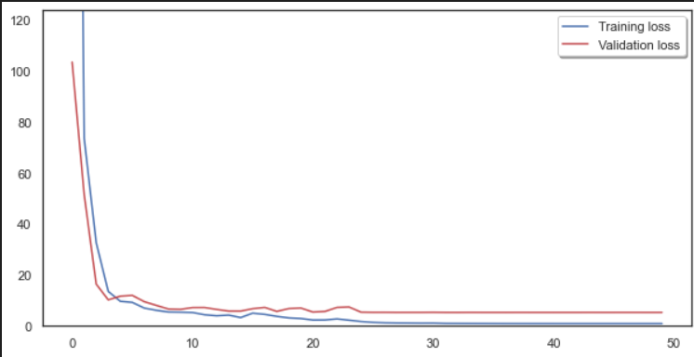
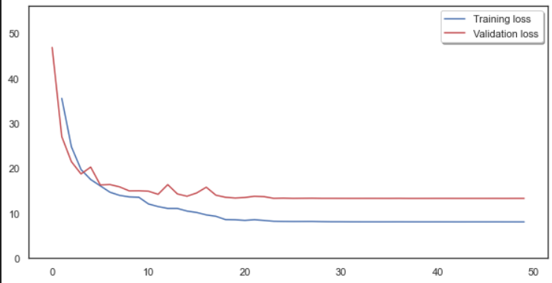
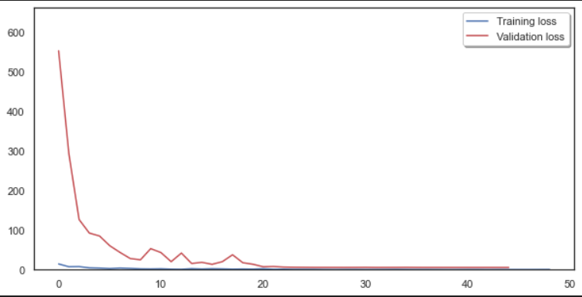
Resnet50 | VGG19
Inception v3 | Mobilenet

Slide 8
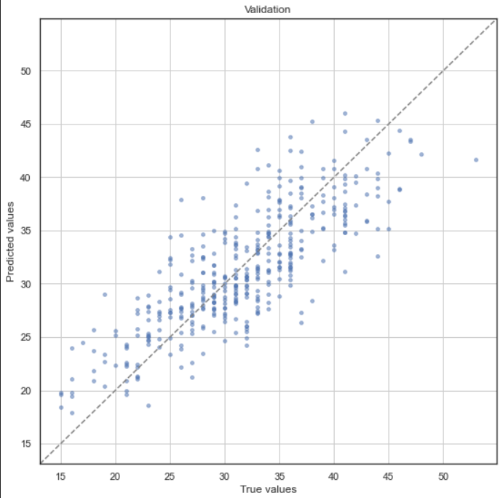
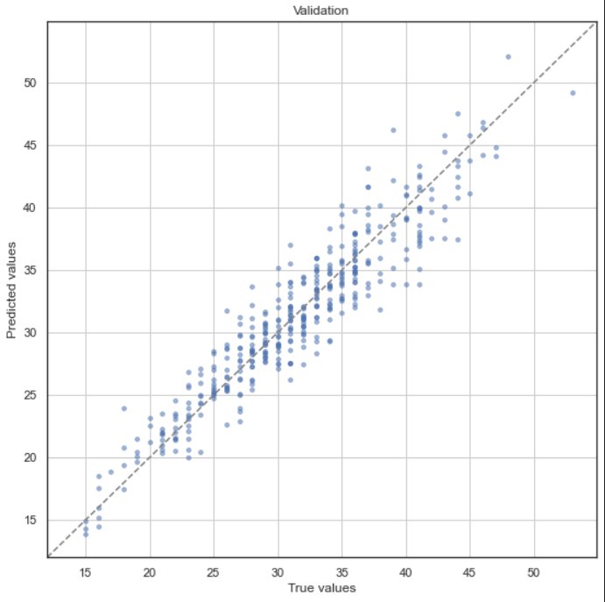
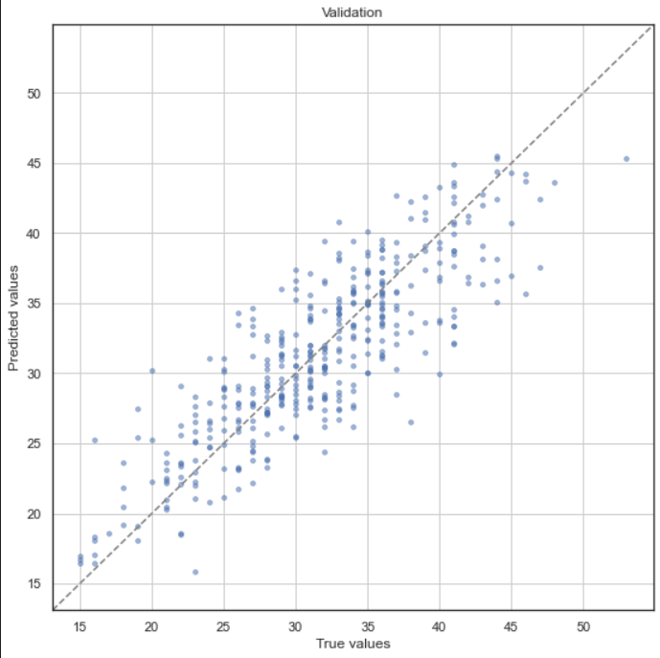
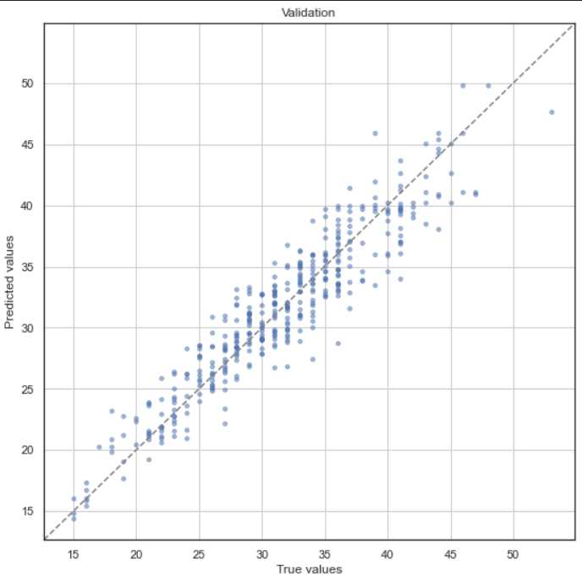
Resnet50 | VGG19
Inception v3 | Mobilenet

Slide 9
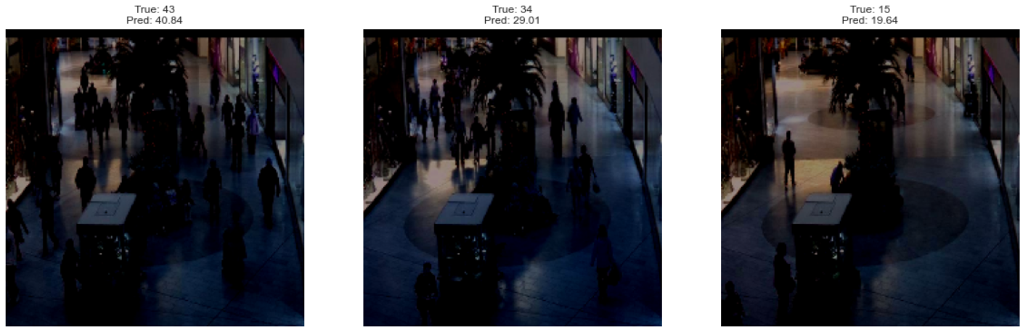
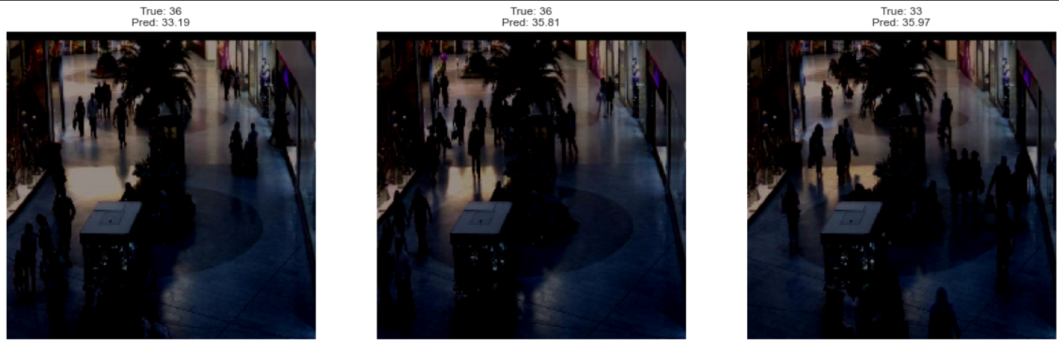
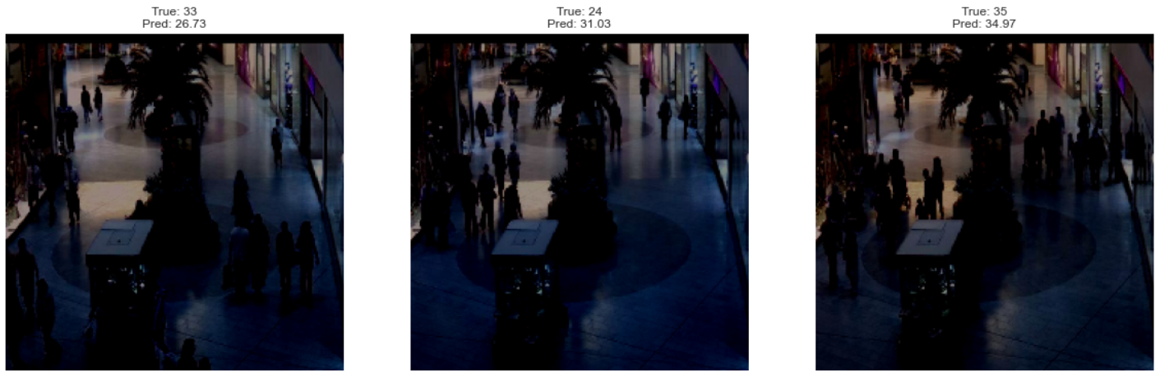
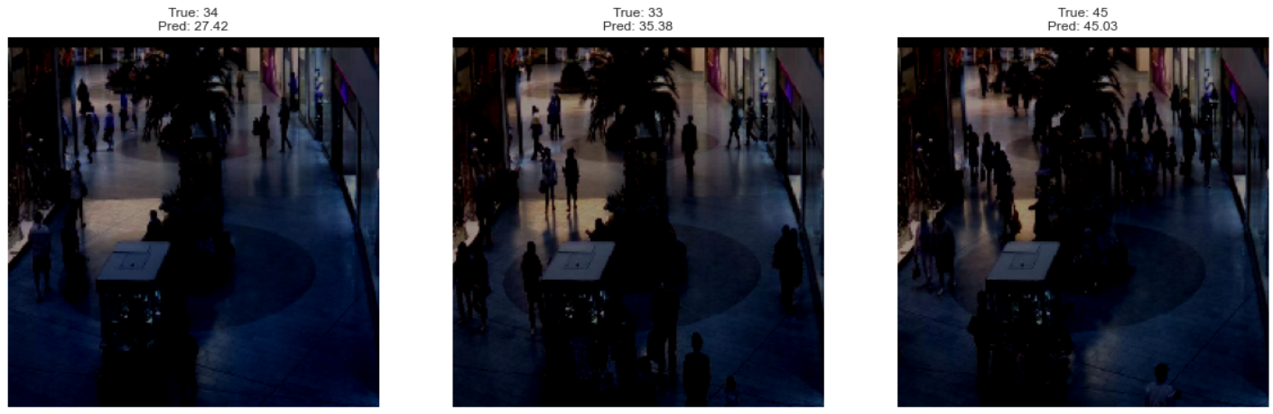
Resnet50 | VGG19
Inception v3 | Mobilenet

Slide 10
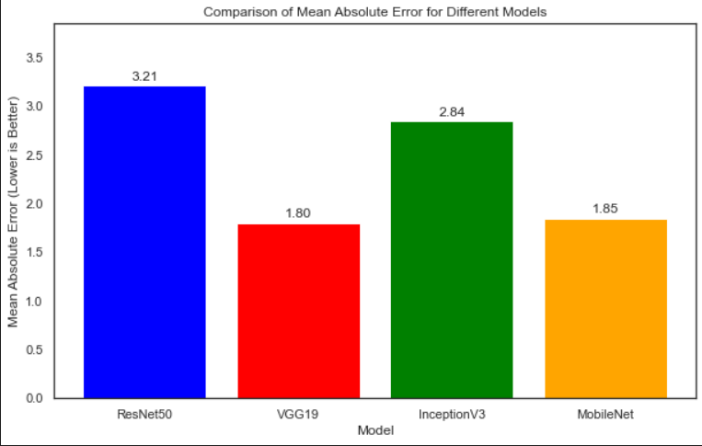
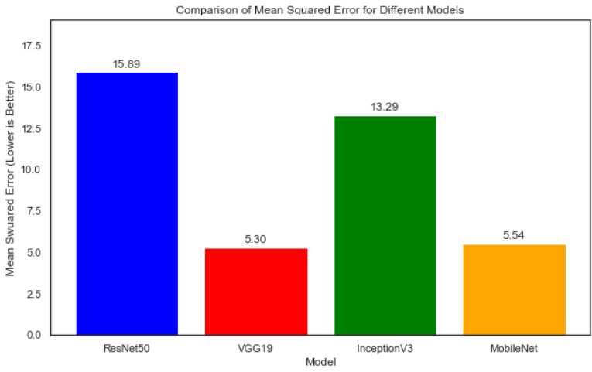
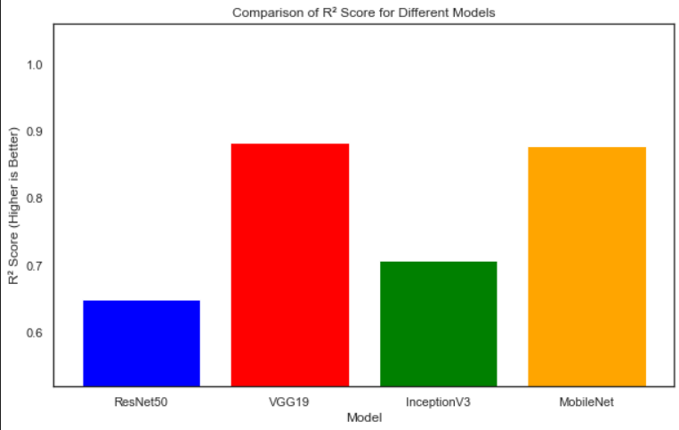
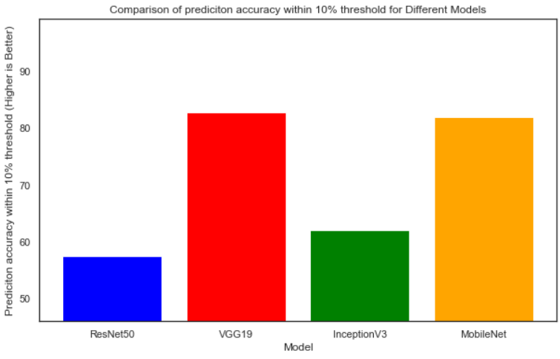

Slide 11
THANK YOU

